Slide 1


Anxiety vs Depression

Slide 2
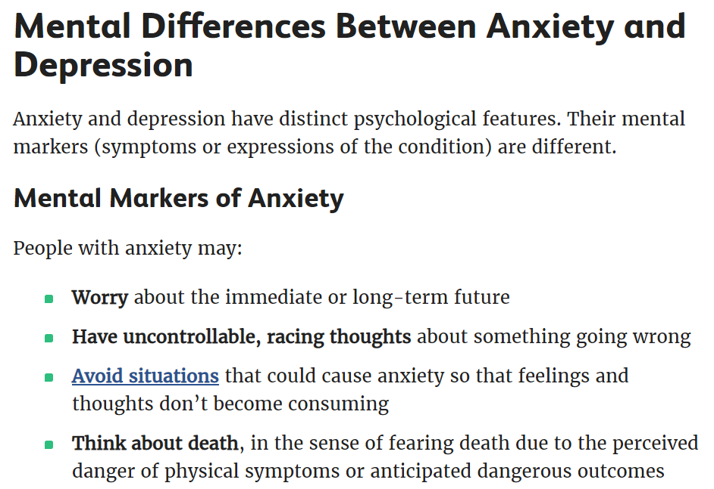
Background
Source: https://www.verywellmind.com/am-i-anxious-4045683
Notes:
More on worrying

Slide 3
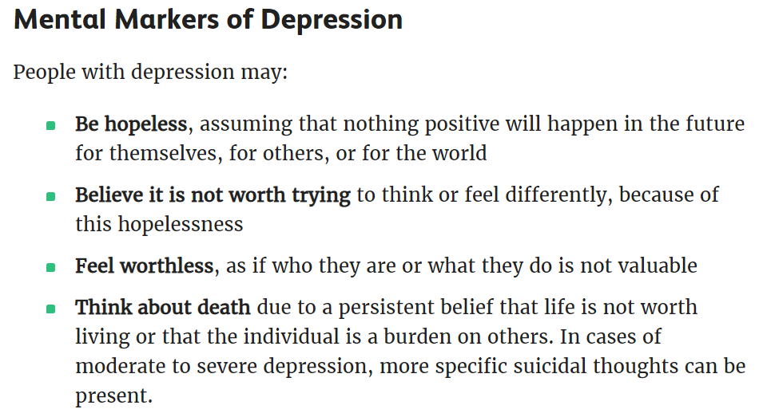
Source: https://www.verywellmind.com/am-i-anxious-4045683
Notes:
More on helpless and hopelessness

Slide 4

Problem Statement
To identify if the text came from either the Anxiety or Depression sub-reddit.
In turn, help mental health practioners, which include counsellors and psychiatrists to have a quick overview if the individual is displaying signs / symptoms of Depression or Anxiety.
Notes:
Models (naive bayes and logistic regression) which will be built to classify and identify if the text came from either the Anxiety or Depression sub-reddit. The top 50 words that is most commonly used in the Depression sub-reddit and Anxiety sub-reddit will be looked at.
From these 50 words , they can help to tell us the different features between Anxiety and Depression.
The model is built in mind to help target stakeholders, who are the mental health practioners, which include counsellors and psychiatrists to have a quick overview if the individual is displaying signs or symptoms of Depression, Anxiety or both.
It is hoped that the model can help to give some clues on the pyschological state of these individuals, how the words they used in their posts show if they are leaning towards depressed or anxiety behaviour.

Slide 5
Approach to tackle Problem Statement
Build Naive bayes and logistic regression models to predict if the text came from Depression or Anxiety sub-reddit.
Models are evaluated based on their generalization to test dataset to select for a final model.
Hopefully, the model can give clues on the pyschological state of these individuals, how the words they used in their posts show if they are leaning towards depression or anxiety.

Slide 6
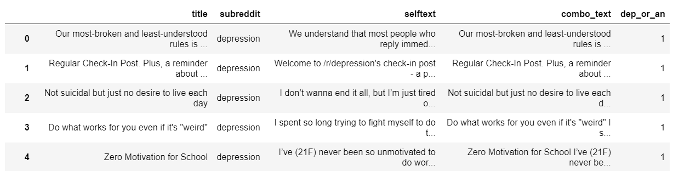
Web-scrape posts from Depression and Anxiety sub-reddits
https://www.reddit.com/r/Anxiety/
https://www.reddit.com/r/depression/

Slide 7
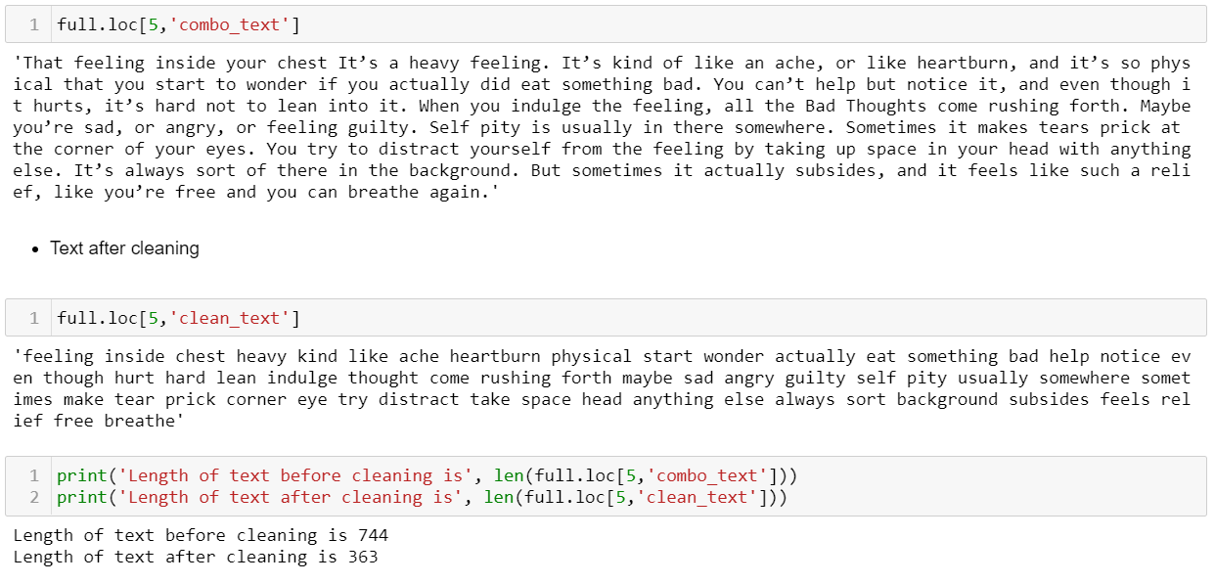
Clean text by regular expression, stop words and lemmetization
Lemmetizer is set to lemmetize nouns, verbs,
adjectives and adverbs
Notes:
Model with nb_cvec after cleaning, accuracy

Slide 8

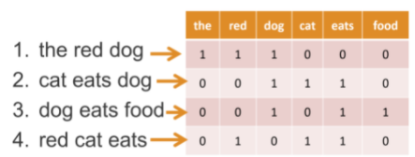
Text Data transformed by Count Vectorizer

Slide 9
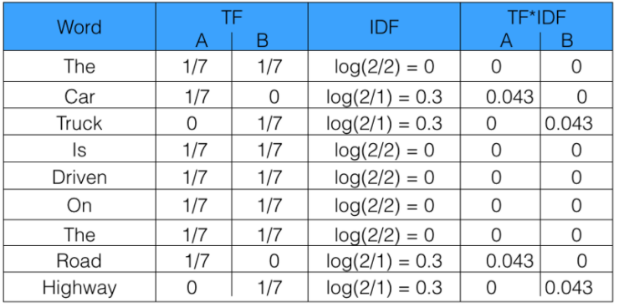
Text data transformed by Term Frequency Inverse Document Frequency (TF-IDF) Vectorizer
https://www.freecodecamp.org/news/how-to-process-textual-data-using-tf-idf-in-python-cd2bbc0a94a3/

Slide 10
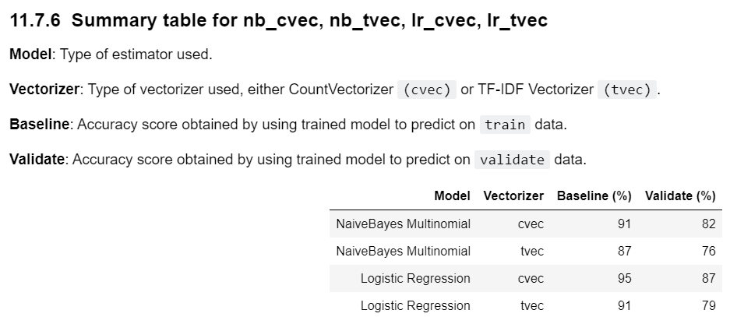

Slide 11
Initial modeling was done with naïve bayes classifier and database obtained from count vectorizer transformation.
To find out the common words learned by the model.
To try and include more stop words to increase model performance.

Slide 12
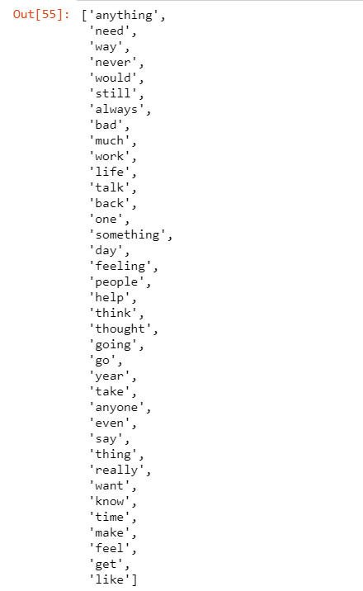
List of common words between Depression and Anxiety after nb_cvec modeling

Slide 13
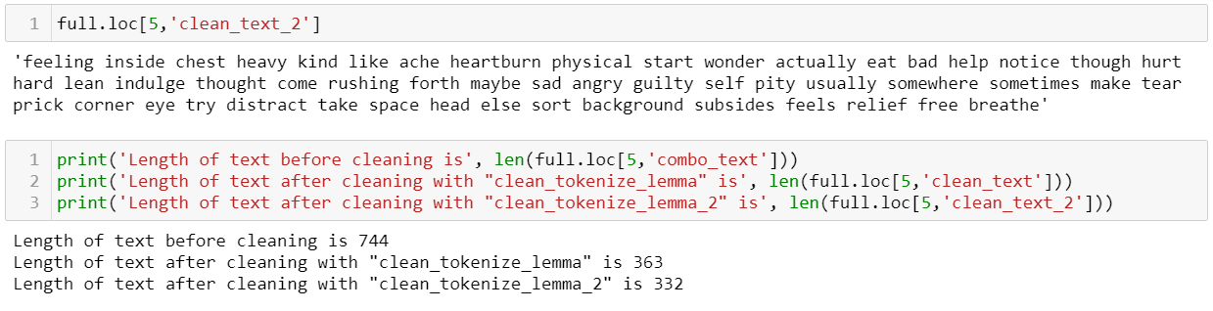
Include more stop words to clean text
Include stopwords:
['anything', 'never', 'would', 'still', 'always', 'much', 'one', 'something', 'even']
Before additional stop words added
After additional stop words added

Slide 14
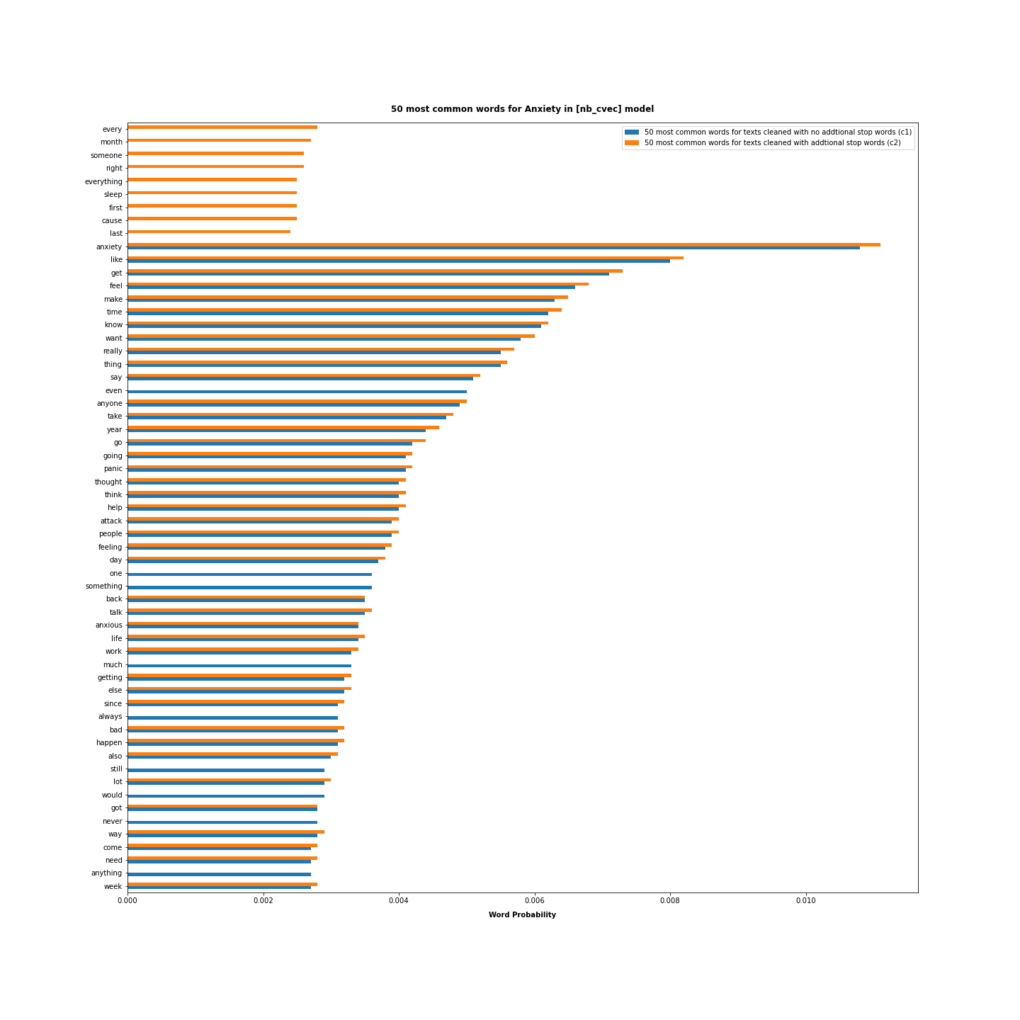
Notes:
50 most common words in Anxiety

Slide 15
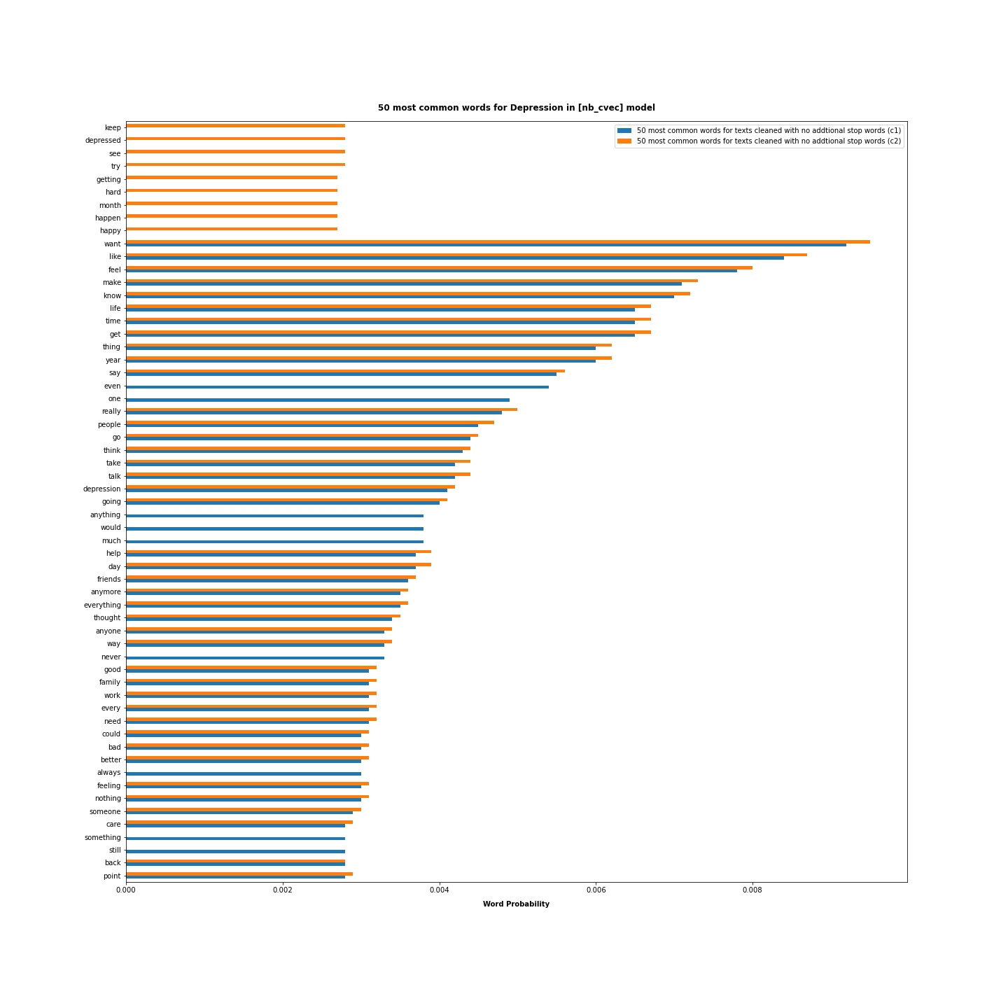
Notes:
50 most common words in Depression

Slide 16
Notes:
Unfortunately the score did not improve, accuracy maintained at 82%. Used back the original cleaned_text
A total of 4 models were built, nb_cvec, nb_tvec, lr_cvec, lr_tvec.

Slide 17
Logistic Regression / CountVectorizer (lr_cvec) is selected.

Slide 18
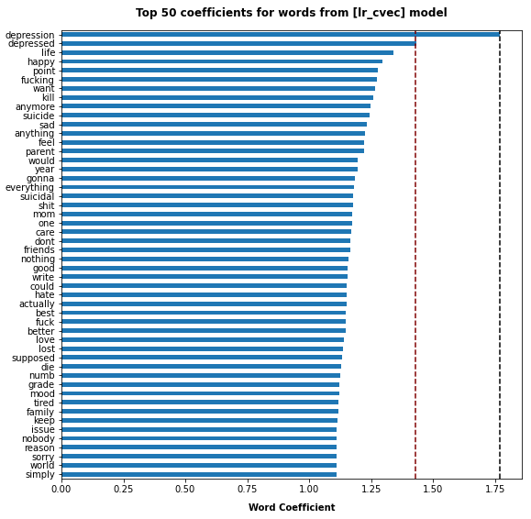
Notes:
- (wrong) using depression as the example, for every 1 increase in mention of depression in the text, the odds of the text about depression increases by 1.77 times, if all other factors are kept constant
(correct) using depression as the example, for every 1 increase in mention of depression in the text, the odds of the text about depression increases by e^1.77(~5.87 times), since model predicts on depression
if all other factors are kept constant

Slide 19
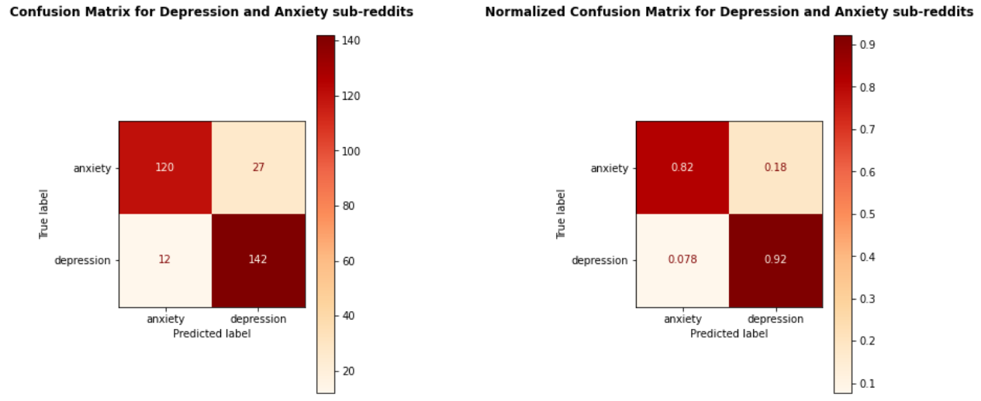
lr_cvec Confusion Matrix

Slide 20
Recommendations & Conclusion
lr_cvec is selected as the final model. It has the lowest difference between baseline and validation score which is 8%.
If the text is about depression, lr_cvec can predict with 92% accuracy. Whereas, if the text is about anxiety, lr_cvec can predict with 82% accuracy.
Other prominent words increasing the propensity of predicting for depression are life, happy, kill, suicide, sad and suicidal.
There are many common words shared between Depression and Anxiety.
Notes:
Recommendations
From the models built, lr_cvec has the highest accuracy.
It can be utilized to identify posts from individuals showing signs or symptoms of depression or anxiety. If the text is about depression, lr_cvec can predict with 97.6% accuracy. Whereas, if the text is about anxiety, lr_cvec can predict with 93.1% accuracy.
The notable words that have a great effect in classifying the text as depression are depression and depressed, which is quite obvious.
As mentioned previously, using depression as the example, for every 1 increase in mention of depression in the text, the odds of the text about depression increases by 1.77 times, if all other factors are kept constant.
Other prominent words are life, happy, kill, suicide, sad and suicidal. For life and happy, if the individual mentions them a lot in their posts, it may mean that they are not happy and are thinking about their lives frequently.
Some interesting words like mom,friends,family, tired, hate can help to classify the post.
Conclusion
Stakeholders may wish to use the model to see if it can help identify symptoms of depression or anxiety from depression or anxiety sub-reddit posts. By extrapolating to their current patients, it may help to identify if their patients are leaning towards depression or anxiety.

Slide 21
Improvements to data processing and modeling
Include more stop words.
Try out more classifiers like decision tree classifier, Random Forest classifier and Xgboost classifier.
Try out Stemming also.
Try out spaCy library to see if it improves the lemmetization.

